Slide 1



Atomix - Your personal laboratory with AI
Members:
LY_Comps_B_62 - Kartik Verma
LY_Comps_B_50 - Kushal Soni
LY_Comps_B_56 - Dhir Thakar
Guide: Dr. Madhura Phadke
Project Title

Slide 2
Outline of Presentation
Introduction
Summary / Finding of Literature Survey
System Design & Architecture
Proposed Methodology( Algorithm / Flowchart etc)
Video & Audio demonstration of Running Project(5Mins)
Results
Conclusion
References

Slide 3
Introduction
Traditional chemistry labs have limitations such as high cost, safety risks, and limited access.
Virtual laboratories provide a safe and interactive environment for performing experiments.
This project develops a Unity-based 3D Virtual Chemistry Lab for experiments, It also includes molecular-level visualization of chemical reactions.
Users can freely choose chemicals, quantities, and procedures instead of fixed steps.
An AI assistant provides explanations through both text and voice to enhance understanding. It is voice-controlled, and it delivers responses in voice as well.

Slide 4
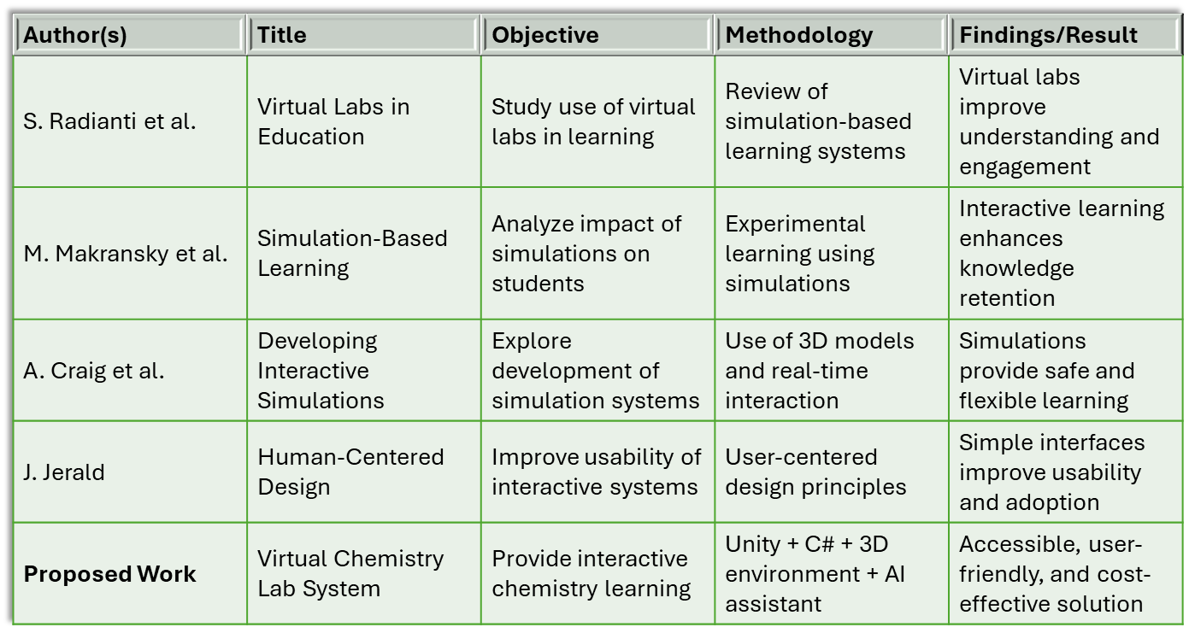
Summary / Finding of Literature Survey

Slide 5
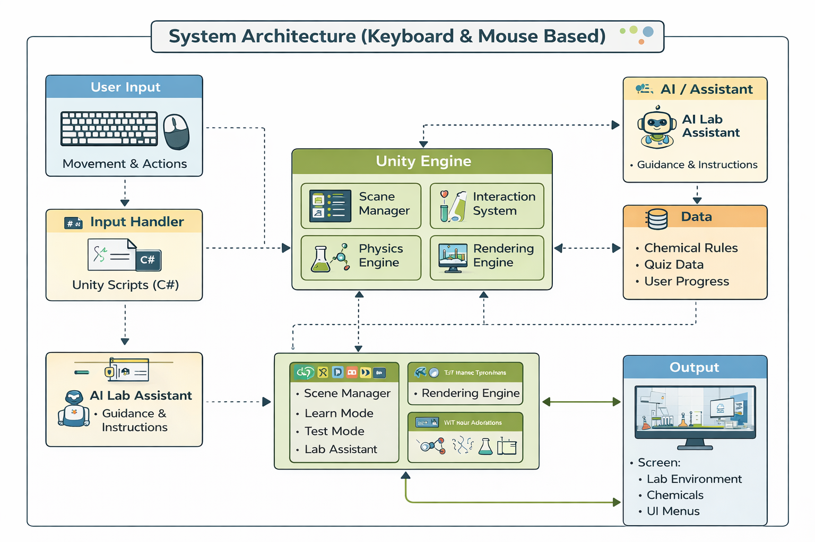
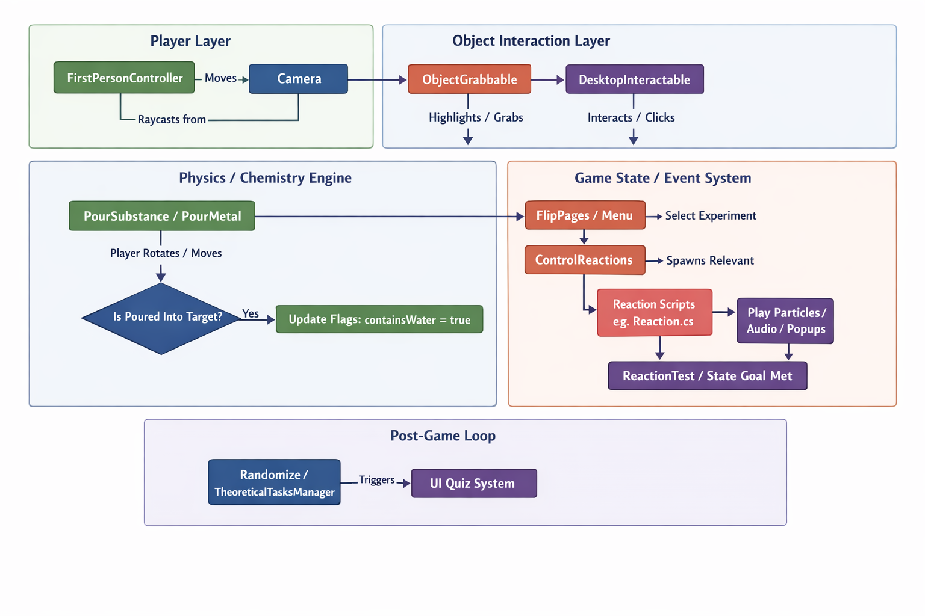
System Design & Architecture

Slide 6
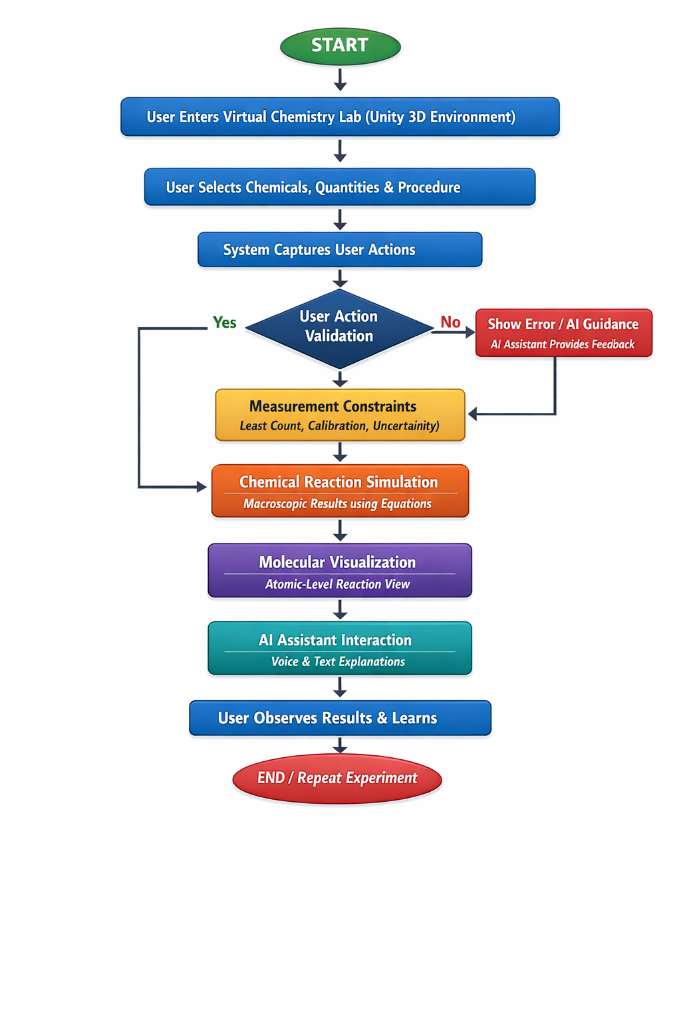
Proposed Methodology( Flowchart)
Measurement constraints -Least count, calibration, and uncertainty are important.
User action validation -Capture and validate user actions against correct procedures in real time.
Chemical reaction simulation -Simulate chemical reactions and macroscopic outcomes using core chemistry equations.
Molecular visualizations -Link actions to molecular-level visualizations for conceptual understanding.

Slide 7
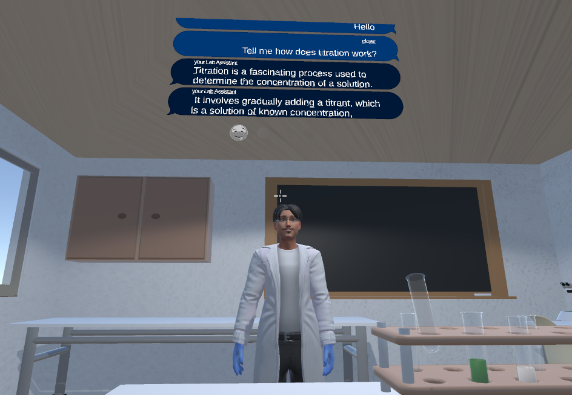
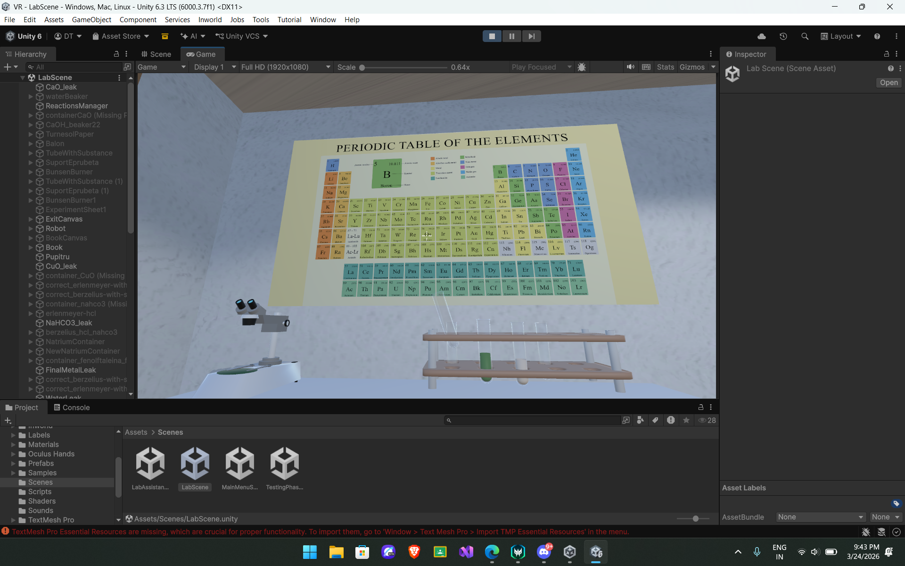
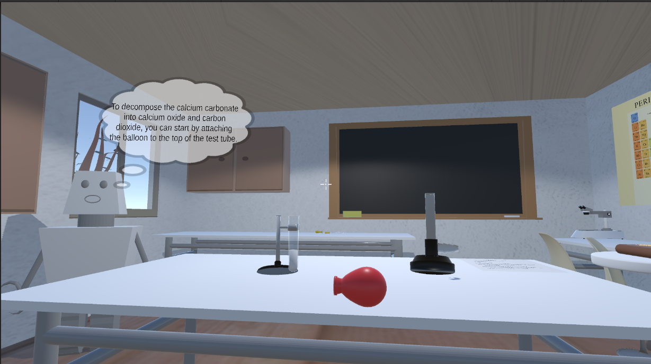
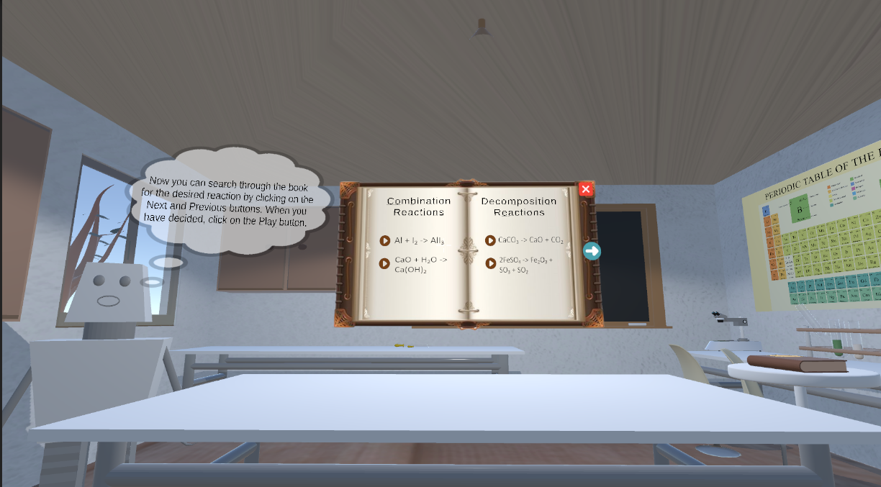
Video & Audio demonstration of Running Project(5Mins)

Slide 8
Results
Successfully developed an interactive virtual chemistry lab
Enabled safe experimentation without real chemicals
Achieved real-time interaction with lab objects and reactions
Integrated AI-based Lab Assistant for guidance

Slide 9
Conclusion
The project provides a safe and cost-effective virtual chemistry learning platform.
Enables free experimentation similar to a real laboratory environment.
AI assistant helps students understand mistakes and chemical concepts easily.
Molecular visualization and graphs improve conceptual understanding of reactions.
Overall, the system makes chemistry learning interactive, visual, and engaging.

Slide 10
References
[1] Unity Technologies, “Unity Real-Time Development Platform,” 2024. [Online]. Available: https://unity.com
[2] Blender Foundation, “Blender – Open Source 3D Creation Suite,” 2024. [Online]. Available: https://www.blender.org
[3] Microsoft, “Visual Studio IDE,” 2024. [Online]. Available: https://visualstudio.microsoft.com
[4] Meta Platforms Inc., “Meta Quest 2 – VR Headset,” 2023. [Online]. Available: https://www.meta.com
[5] Inworld AI, “Inworld AI Platform for Virtual Characters,” 2024. [Online]. Available: https://www.inworld.ai

Slide 11
